Slide 1







The Future of Work:
Preparing for AI Integration in Your Career
Microsoft Azure Community Meetup
Priya Amulraj, Life & Career Transition Coach
14th June 2025

Slide 2
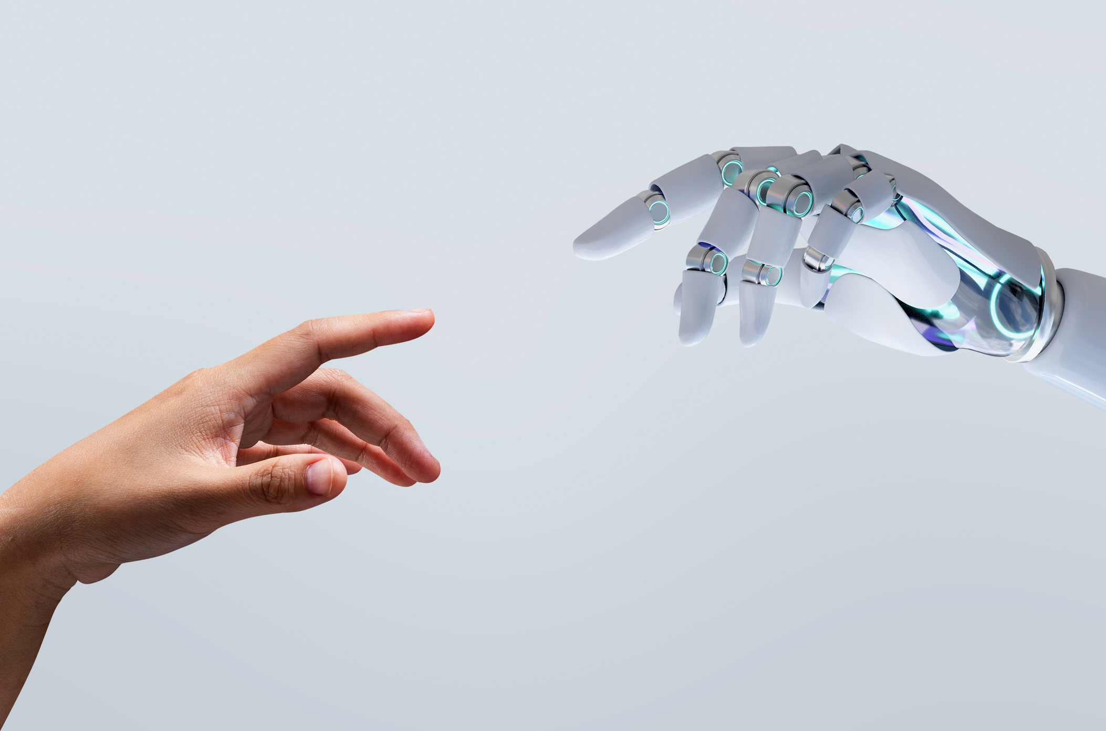


Joy to be here with you today!
“We’re building the future together.” 🚀

Slide 3



Meet
Priya Amulraj
Life & Career Transition Coach, Mentor, and Motivational Speaker
From confusion, overwhelm, and self-doubt ➔ to clarity, emotional resilience, and fulfillment.
Empowered 450+ amazing individuals to design a life they love — and you’re next. 🌈

Slide 4
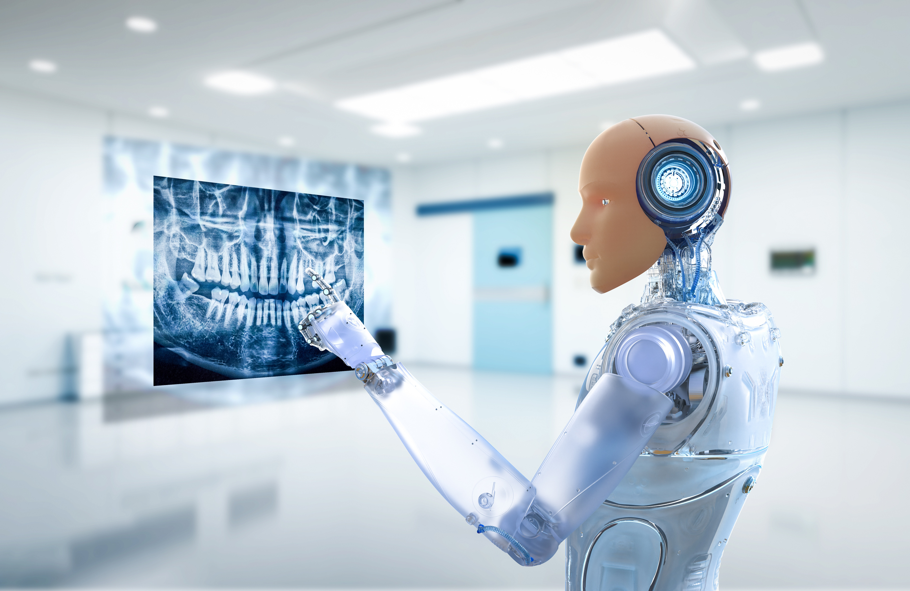
Why This Matters
How many have used AI tools recently?
Transformative force not buzzword
Key Point: AI isn’t the enemy — irrelevance is.
You don’t need to know everything - Evolve.

Slide 5





The Shift Is Here
Global Shift in Work & Tech:
AI’s impact in Tech
Truth?
3 Key Trends:
AI is Everywhere; WEF
Career Paths are Non-Linear
Human Skills Are a Differentiator - what humans can only bring to table

Slide 6

Your
Human Edge
(AI can outpace you in speed)
5 Irreplaceable Skills:
Emotional Intelligence
Creativity & Innovation
Critical Thinking - What should it do
Adaptability (✋)
Storytelling & Human Connection

Slide 7

Which one will you commit to developing in the next 30 days?

Slide 8

Future-Proofing Starts With You
(Let’s talk action)
3 Ways to Future-Proof:
Continuous Learning - 1 new per quarter.
Collaborate with AI, Don’t Compete- must become AI-aware
Build Your Personal Brand
How many of you Google someone before trusting their skills?

Slide 9
Pick one action from today — — and commit to doing it within the next 7 days.
Signing up/ experimenting / posting 1st project update/ ?

Slide 10

The R.E.A.D.Y Path to AI-Integrated Success
Rewire Your Mindset - Fear to Opportunity
Explore Emerging Tech
Acquire Transferable Skills
Design Your Growth Path
Yes to Community & Collaboration

Slide 11
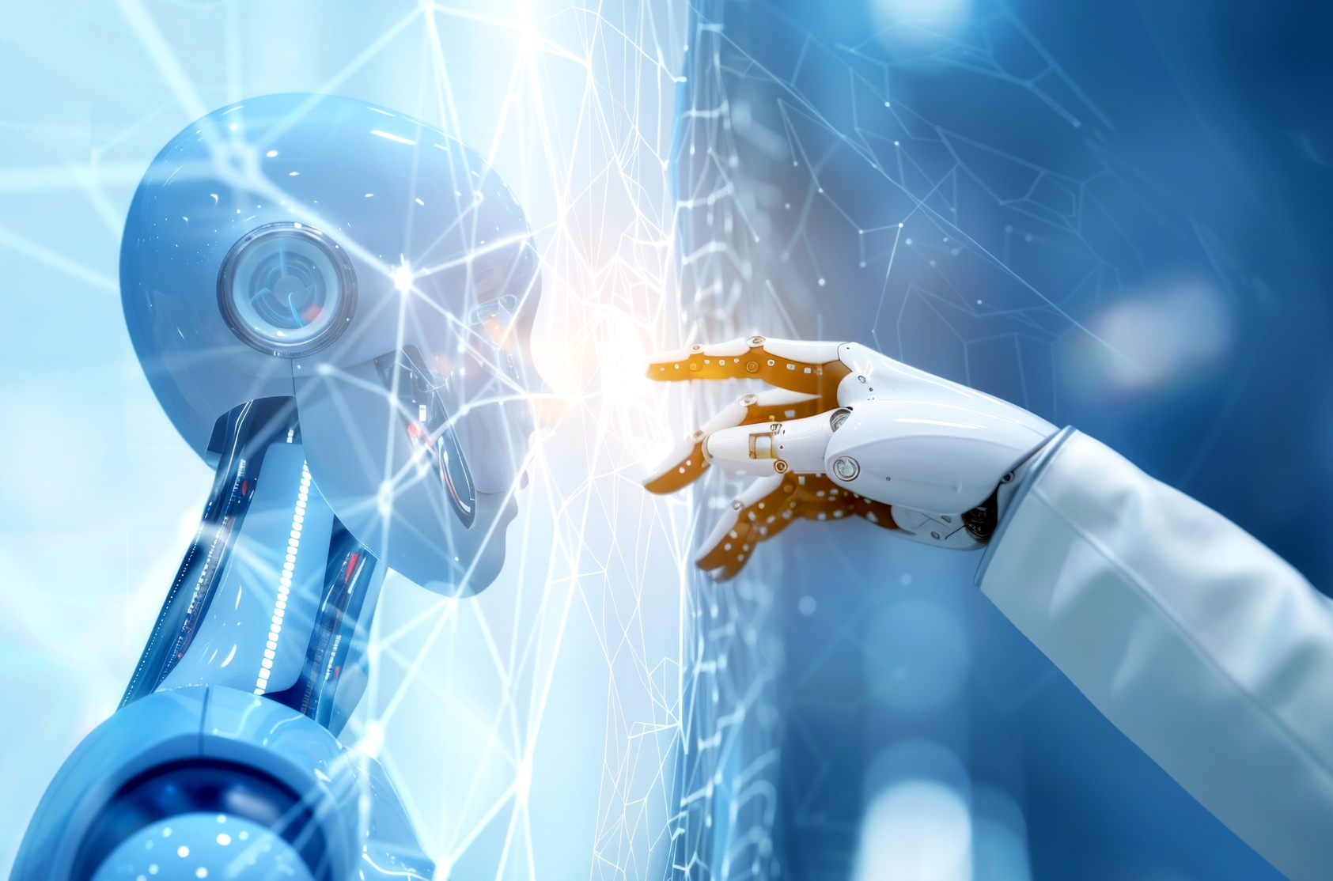
“AI is not here to replace you. It’s here to amplify you.
Be the one who doesn’t just adapt — but leads, mentors, and shapes what’s coming next.”

Slide 12

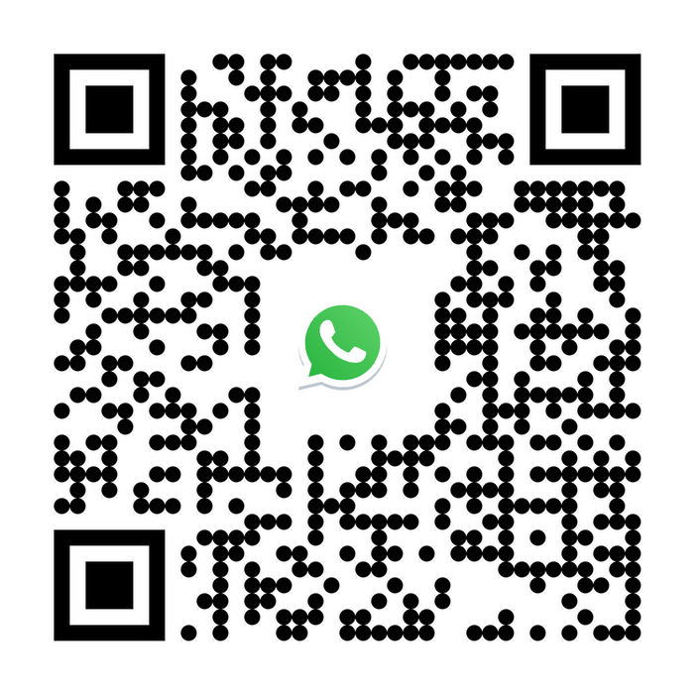


From Fear to Fuel
Your Personal AI Career Checklist: 5 Steps to Thrive in an AI-Integrated World
I am not afraid of the future — I’m prepared for it.

Slide 13
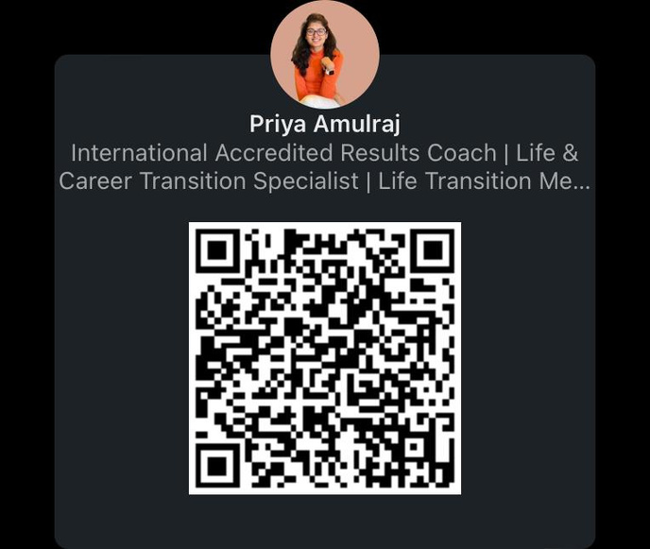

Thank you for your presence and energy!
Email
lifecoachpriyaamulraj@gmaail.com
Whatsapp
+91 9629712444

